Slide 1
Operations Management
William J. Stevenson
8th edition

Slide 2
CHAPTER
1
Introduction to
Operations Management
Manufacturing Sector in India: Market Size, FDI, Govt Initiatives | IBEF
Operations Management, Eighth Edition, by William J. Stevenson
Copyright © 2005 by The McGraw-Hill Companies, Inc. All rights reserved.
McGraw-Hill/Irwin

Slide 3
Operations Management
Figure 1.1
The management of systems or processes
that create goods and/or provide services
Organization
Finance
Operations
Marketing
Kia Motors | India Plant - YouTube

Slide 4
Value-Added
Figure 1.2
The difference between the cost of inputs
and the value or price of outputs.
Value added
Inputs
Transformation/
Outputs
Land
Conversion
Goods
Labor
process
Services
Capital
Feedback
Control
Feedback
Feedback

Slide 5
Goods-service Continuum
Figure 1.3
Steel production
Automobile fabrication
Home remodeling
Retail sales
Auto Repair
Appliance repair
Maid Service
Manual car wash
Teaching
Lawn mowing
High percentage goods
Low percentage service
Low percentage goods
High percentage service

Slide 6
Food Processor
Table 1.2
Inputs
Processing
Outputs
Raw Vegetables
Cleaning
Canned
vegetables
Metal Sheets
Making cans
Water
Cutting
Energy
Cooking
Labor
Packing
Building
Labeling
Equipment

Slide 7
Hospital Process
Table 1.2
Inputs
Processing
Outputs
Doctors, nurses
Examination
Healthy
patients
Hospital
Surgery
Medical Supplies
Monitoring
Equipment
Medication
Laboratories
Therapy

Slide 8
Manufacturing or Service?
Tangible
Act

Slide 9
Production of Goods vs. Delivery of Services
Production of goods – tangible output
Delivery of services – an act
Service job categories
  Government
  Wholesale/retail
  Financial services
  Healthcare
  Personal services
  Business services
  Education

Slide 10
Key Differences
Customer contact
Uniformity of input
Labor content of jobs
Uniformity of output
Measurement of productivity
Production and delivery
Quality assurance
Amount of inventory

Slide 11
Manufacturing vs Service
Characteristic
Manufacturing
Service
Output
Tangible
Intangible
Customer contact
Low
High
Uniformity of input
High
Low
Labor content
Low
High
Uniformity of output
High
Low
Measurement of productivity
Easy
Difficult
Opportunity to correct
High
Low
quality problems
High

Slide 12
Scope of Operations Management
Operations Management includes:
  Forecasting
  Capacity planning
  Scheduling
  Managing inventories
  Assuring quality
  Motivating employees
  Deciding where to locate facilities
  And more . . .

Slide 13
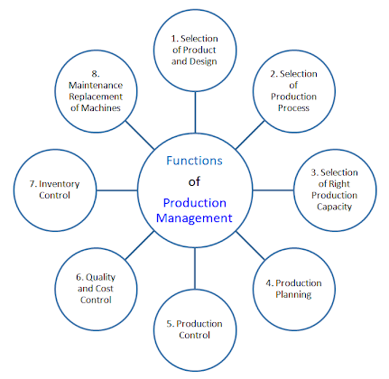

Slide 14
Types of Operations
Table 1.4
Operations
Examples
Goods Producing
Farming, mining, construction
,
manufacturing, power generation
Storage/Transportation
Warehousing, trucking, mail
service, moving, taxis, buses,
hotels, airlines
Exchange
Retailing, wholesaling, banking,
renting, leasing, library, loans
Entertainment
Films, radio and television,
concerts, recording
Communication
Newspapers, radio and television
newscasts, telephone, satellites

Slide 15
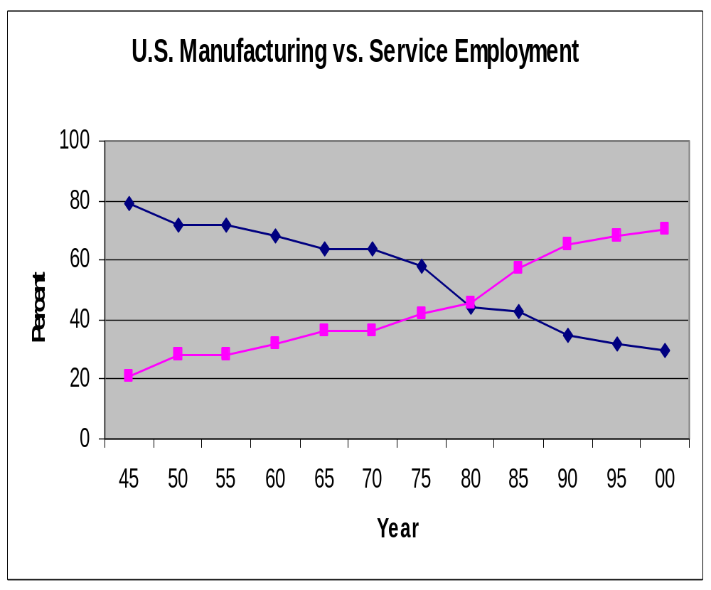
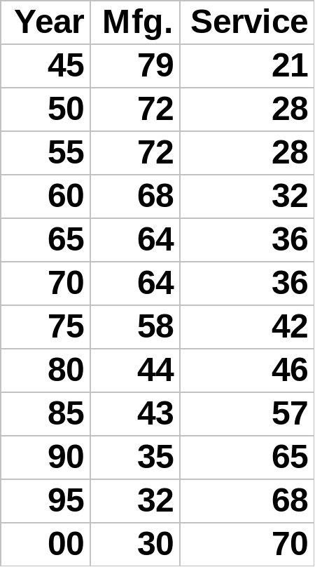
Figure 1.4

Slide 16
Responsibilities of Operations Management
Table 1.6
Planning
Organizing
–
Capacity
–
Degree of centralization
–
Location
–
Process selection
–
Products & services
Staffing
–
Make or buy
–
Hiring/laying off
–
Layout
–
Use of Overtime
–
Projects
Directing
–
Scheduling
–
Incentive plans
Controlling/Improving
–
Issuance of work orders
–
Inventory
–
Job assignments
–
Quality
–
Costs
–
Productivity

Slide 17
Key Decisions of Operations Managers
What
  What resources/what amounts
When
  Needed/scheduled/ordered
Where
  Work to be done
How
  Designed
Who
  To do the work

Slide 18
Decision Making
System Design
–
capacity
–
location
–
arrangement of departments
–
product and service planning
–
acquisition and placement of
equipment

Slide 19
Decision Making
System operation
–
personnel
–
inventory
–
scheduling
–
project
management
–
quality assurance

Slide 20
Decision Making
Models
Quantitative approaches
Analysis of trade-offs
Systems approach

Slide 21
Models
A model is an abstraction of reality.
–
Physical
–
Schematic
Tradeoffs
–
Mathematical
What are the pros and cons of models?

Slide 22
Models Are Beneficial
Easy to use, less expensive
Require users to organize
Systematic approach to problem solving
Increase understanding of the problem
Enable “what if” questions
Specific objectives
Consistent tool
Power of mathematics
Standardized format

Slide 23
Quantitative Approaches
Linear programming
Queuing Techniques
Inventory models
Project models
Statistical models

Slide 24
Systems Approach
“The whole is greater than
the sum of the parts.”
Suboptimization

Slide 25
Pareto Phenomenon
A few factors account for a high percentage of the occurrence of some event(s).
80/20 Rule - 80% of problems are caused by 20% of the activities.
How do we identify the vital few?

Slide 26
Business Operations Overlap
Figure 1.5
Operations
Marketing
Finance

Slide 27
Operations Interfaces
Industrial
Engineering
Maintenance
Distribution
Purchasing
Public
Relations
Operations
Legal
Personnel
Accounting
MIS

Slide 28
Historical Evolution of Operations Management
Table 1.7
Industrial revolution (1770’s)
Scientific management (1911)
  Mass production
  Interchangeable parts
  Division of labor
Human relations movement (1920-60)
Decision models (1915, 1960-70’s)
Influence of Japanese manufacturers

Slide 29
Trends in Business
Major trends
  The Internet, e-commerce, e-business
  Management technology
  Globalization
  Management of supply chains
  Agility

Slide 30
Simple Product Supply Chain
Figure 1.7
Suppliers’ Suppliers
Direct
Suppliers
Final
Consumer
Producer
Distributor
Supply Chain: A sequence of activities
And organizations involved in producing
And delivering a good or service

Slide 31
A Supply Chain for Bread
Stage of Production | Value Added | Value of Product
Farmer produces and harvests wheat | $0.15 | $0.15
Wheat transported to mill | $0.08 | $0.23
Mill produces flour | $0.15 | $0.38
Flour transported to baker | $0.08 | $0.46
Baker produces bread | $0.54 | $1.00
Bread transported to grocery store | $0.08 | $1.08
Grocery store displays and sells bread | $0.21 | $1.29
Total Value-Added | $1.29

Slide 32
Other Important Trends
Ethical behavior
Operations strategy
Working with fewer resources
Cost control and productivity
Quality and process improvement
Increased regulation and product liability
Lean production

